Slide 1

Introduction to Probabilistic Machine Learning
Ralf Herbrich
Inference & Decision Making

Slide 2
Overview
Inference Methods
Bayesian Inference
Maximum Likelihood Estimation
Decision Making

Slide 3
Overview
Inference Methods
Bayesian Inference
Maximum Likelihood Estimation
Decision Making

Slide 4
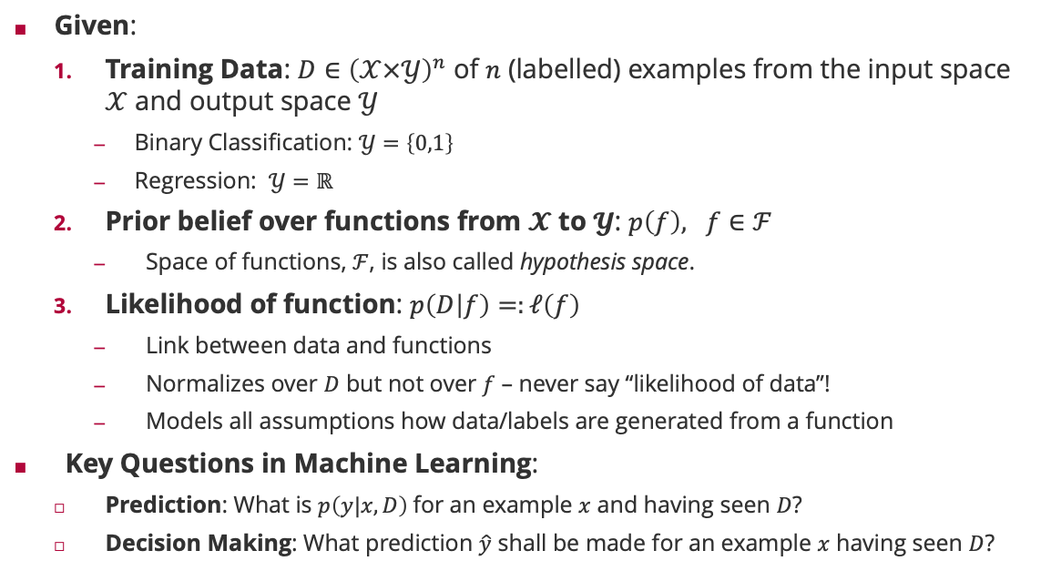
Probabilistic Machine Learning: Terminology
Given:
Training Data: $D∈{\left(𝒳×𝒴\right)}^{n}$ of $n$ (labelled) examples from the input space $𝒳$ and output space $𝒴$
Binary Classification: $𝒴=\left\{0,1\right\}$
Regression: $𝒴=ℝ$
Prior belief over functions from $𝓧$ to $𝓨$: $p\left(f\right), f∈ℱ$
Space of functions, $ℱ$, is also called hypothesis space.
Likelihood of function: $p\left(D | f\right)=:ℓ\left(f\right)$
Link between data and functions
Normalizes over $D$ but not over $f$ – never say “likelihood of data”!
Models all assumptions how data/labels are generated from a function
Key Questions in Machine Learning:
Prediction: What is $p\left(y|x,D\right)$for an example $x$ and having seen $D$?
Decision Making: What prediction $\hat{y}$ shall be made for an example $x$ having seen $D$?

Slide 5
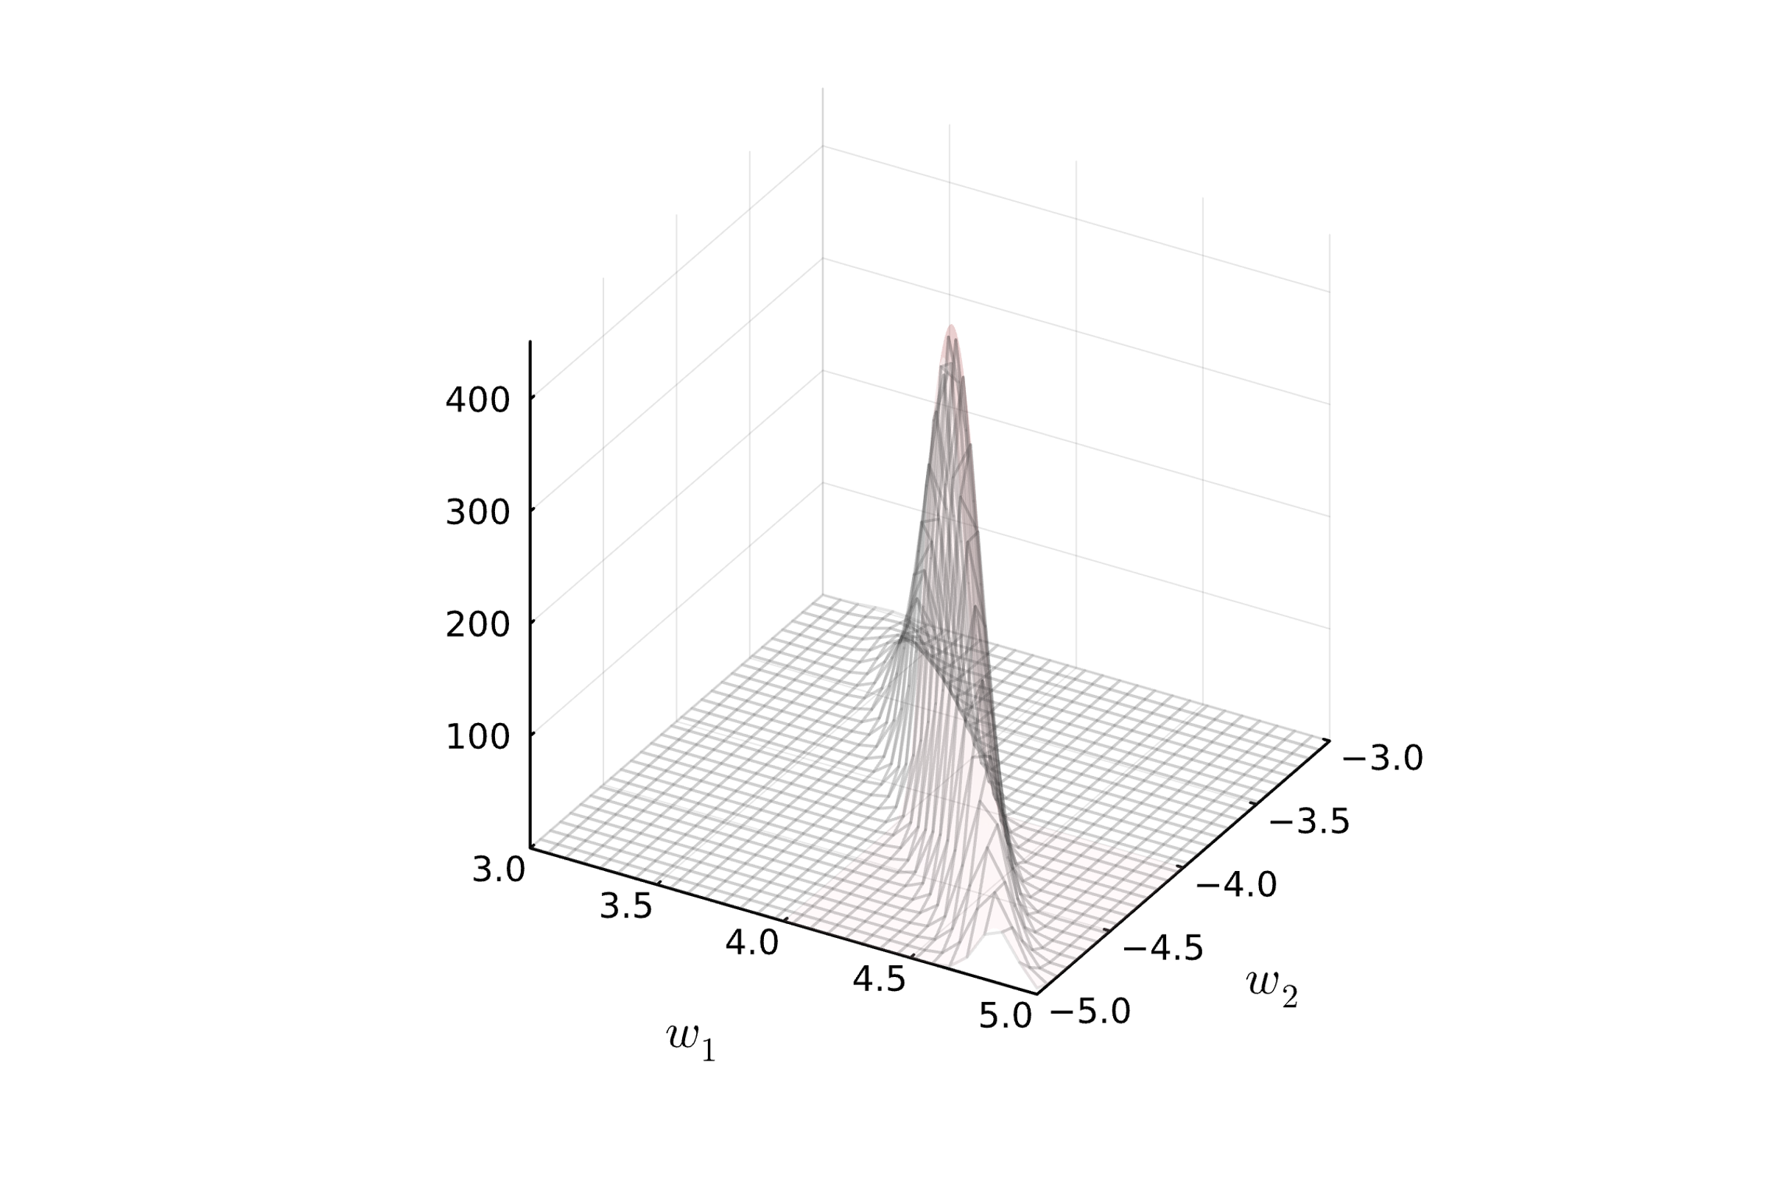
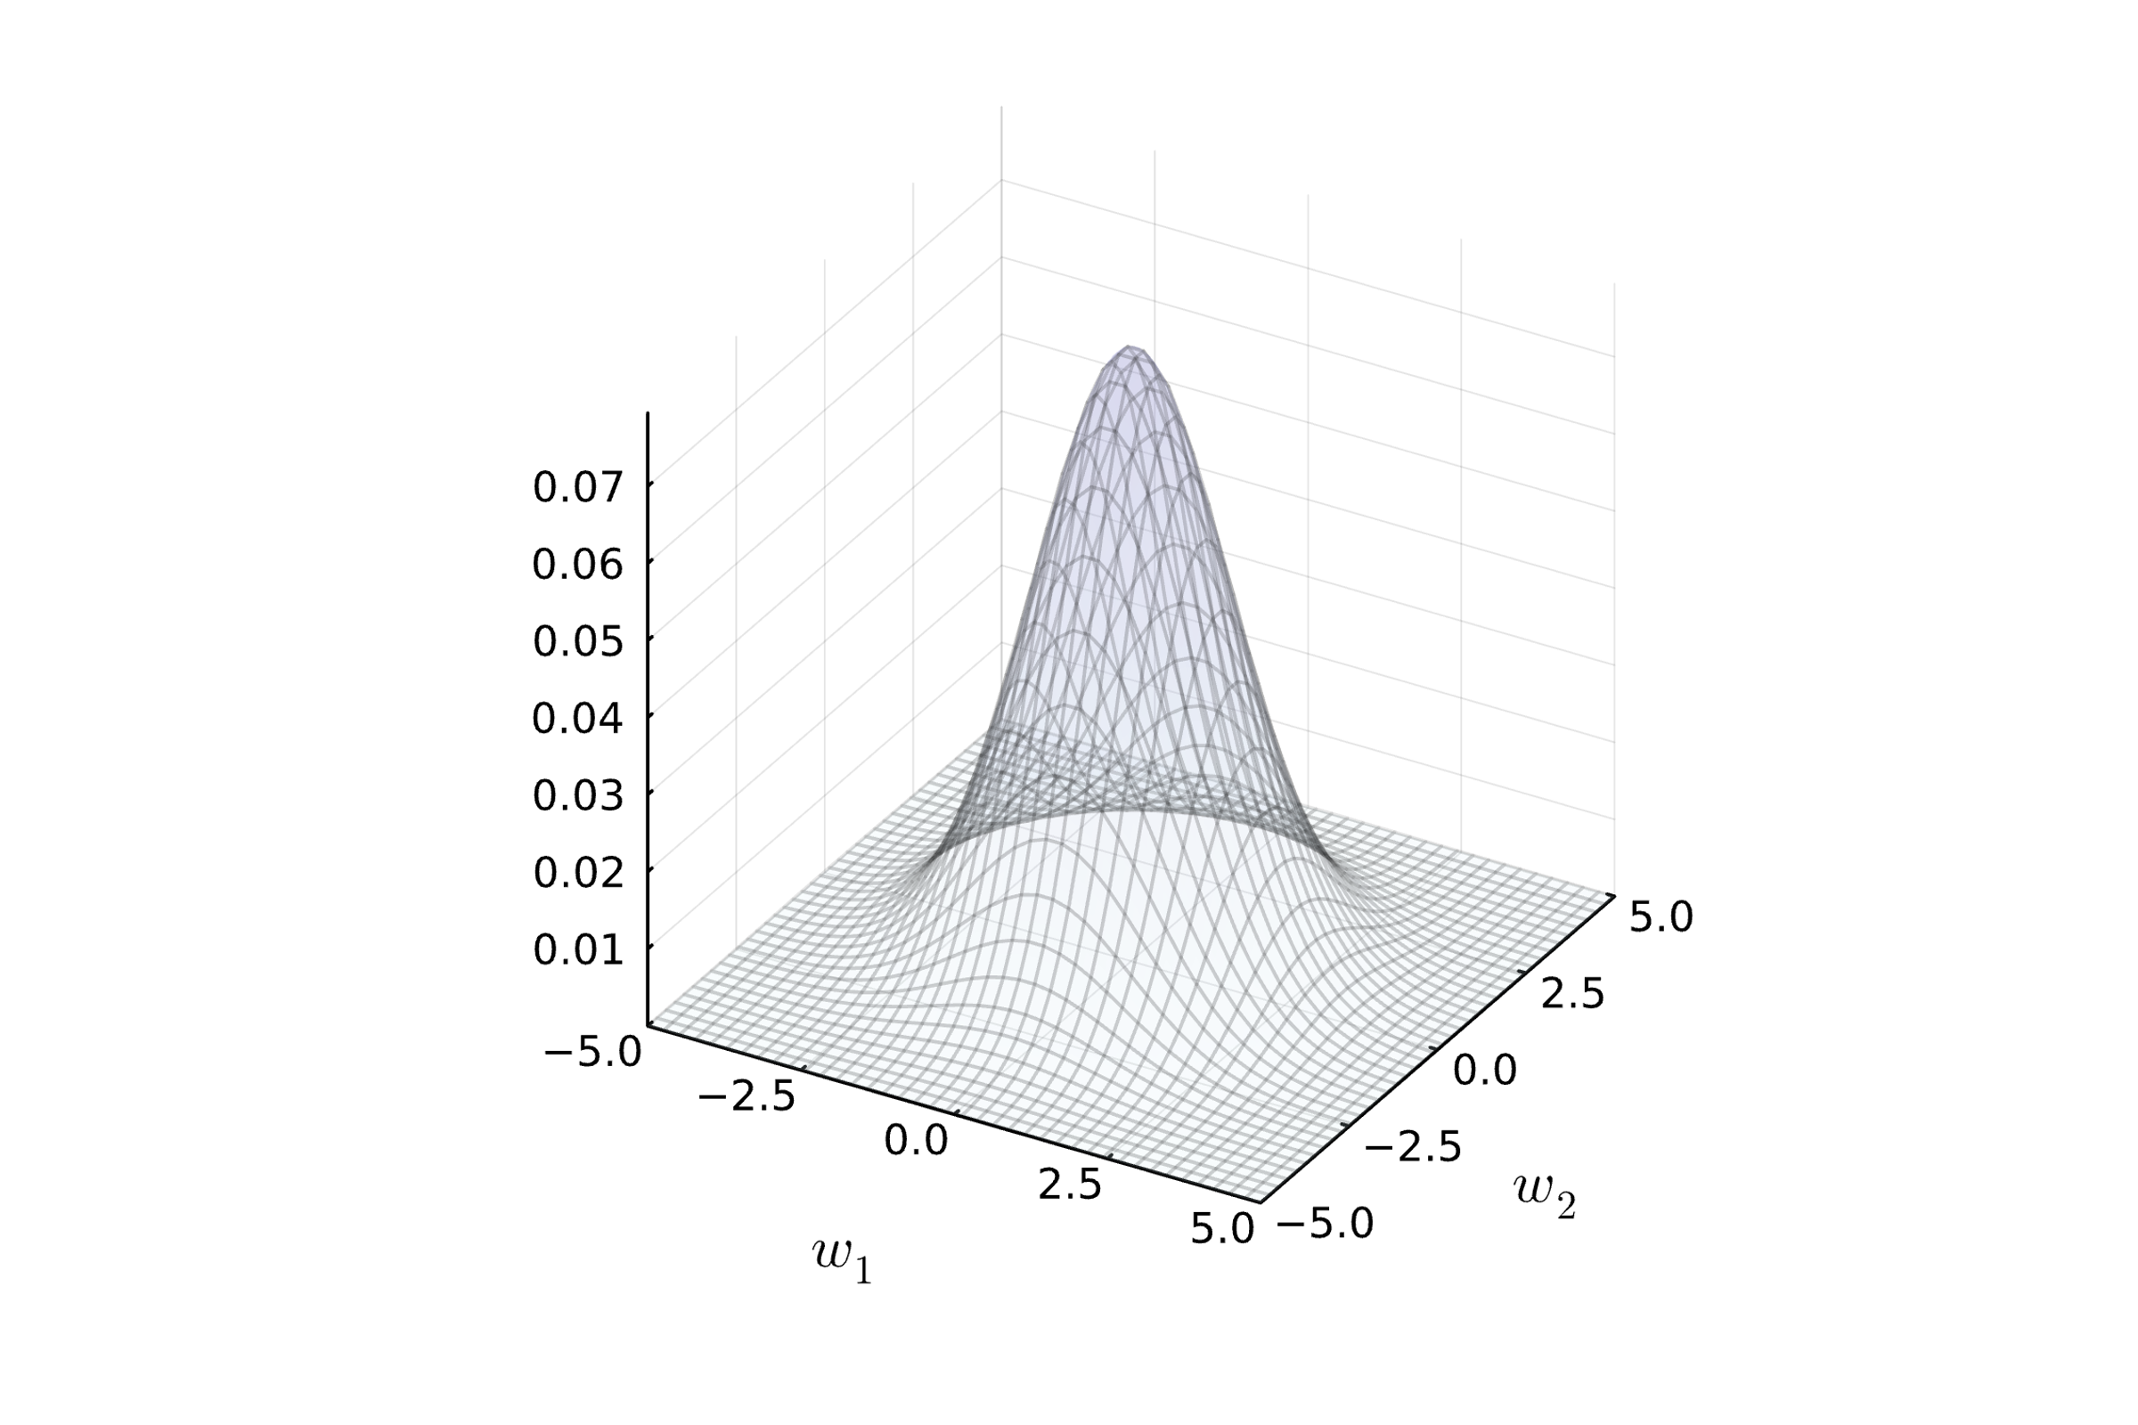
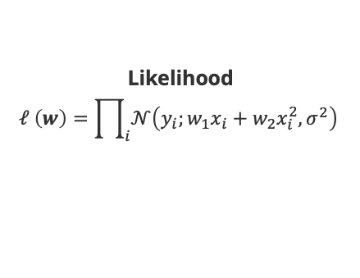
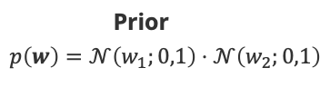

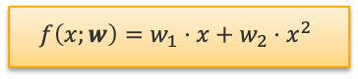
Probabilistic Machine Learning: Polynomial Regression
Likelihood
$$ℓ \left(w\right)=\prod_{i}{𝒩\left(y_{i};w_{1}x_{i}+w_{2}x_{i}^{2},σ^{2}\right)}$$
Training Data
$$D∈ℝ^{2}$$
Prior
$$p\left(w\right)=𝒩\left(w_{1};0,1\right)⋅𝒩\left(w_{2};0,1\right)$$
$$f\left(x;w\right)=w_{1}⋅x+w_{2}⋅x^{2}$$

Slide 6
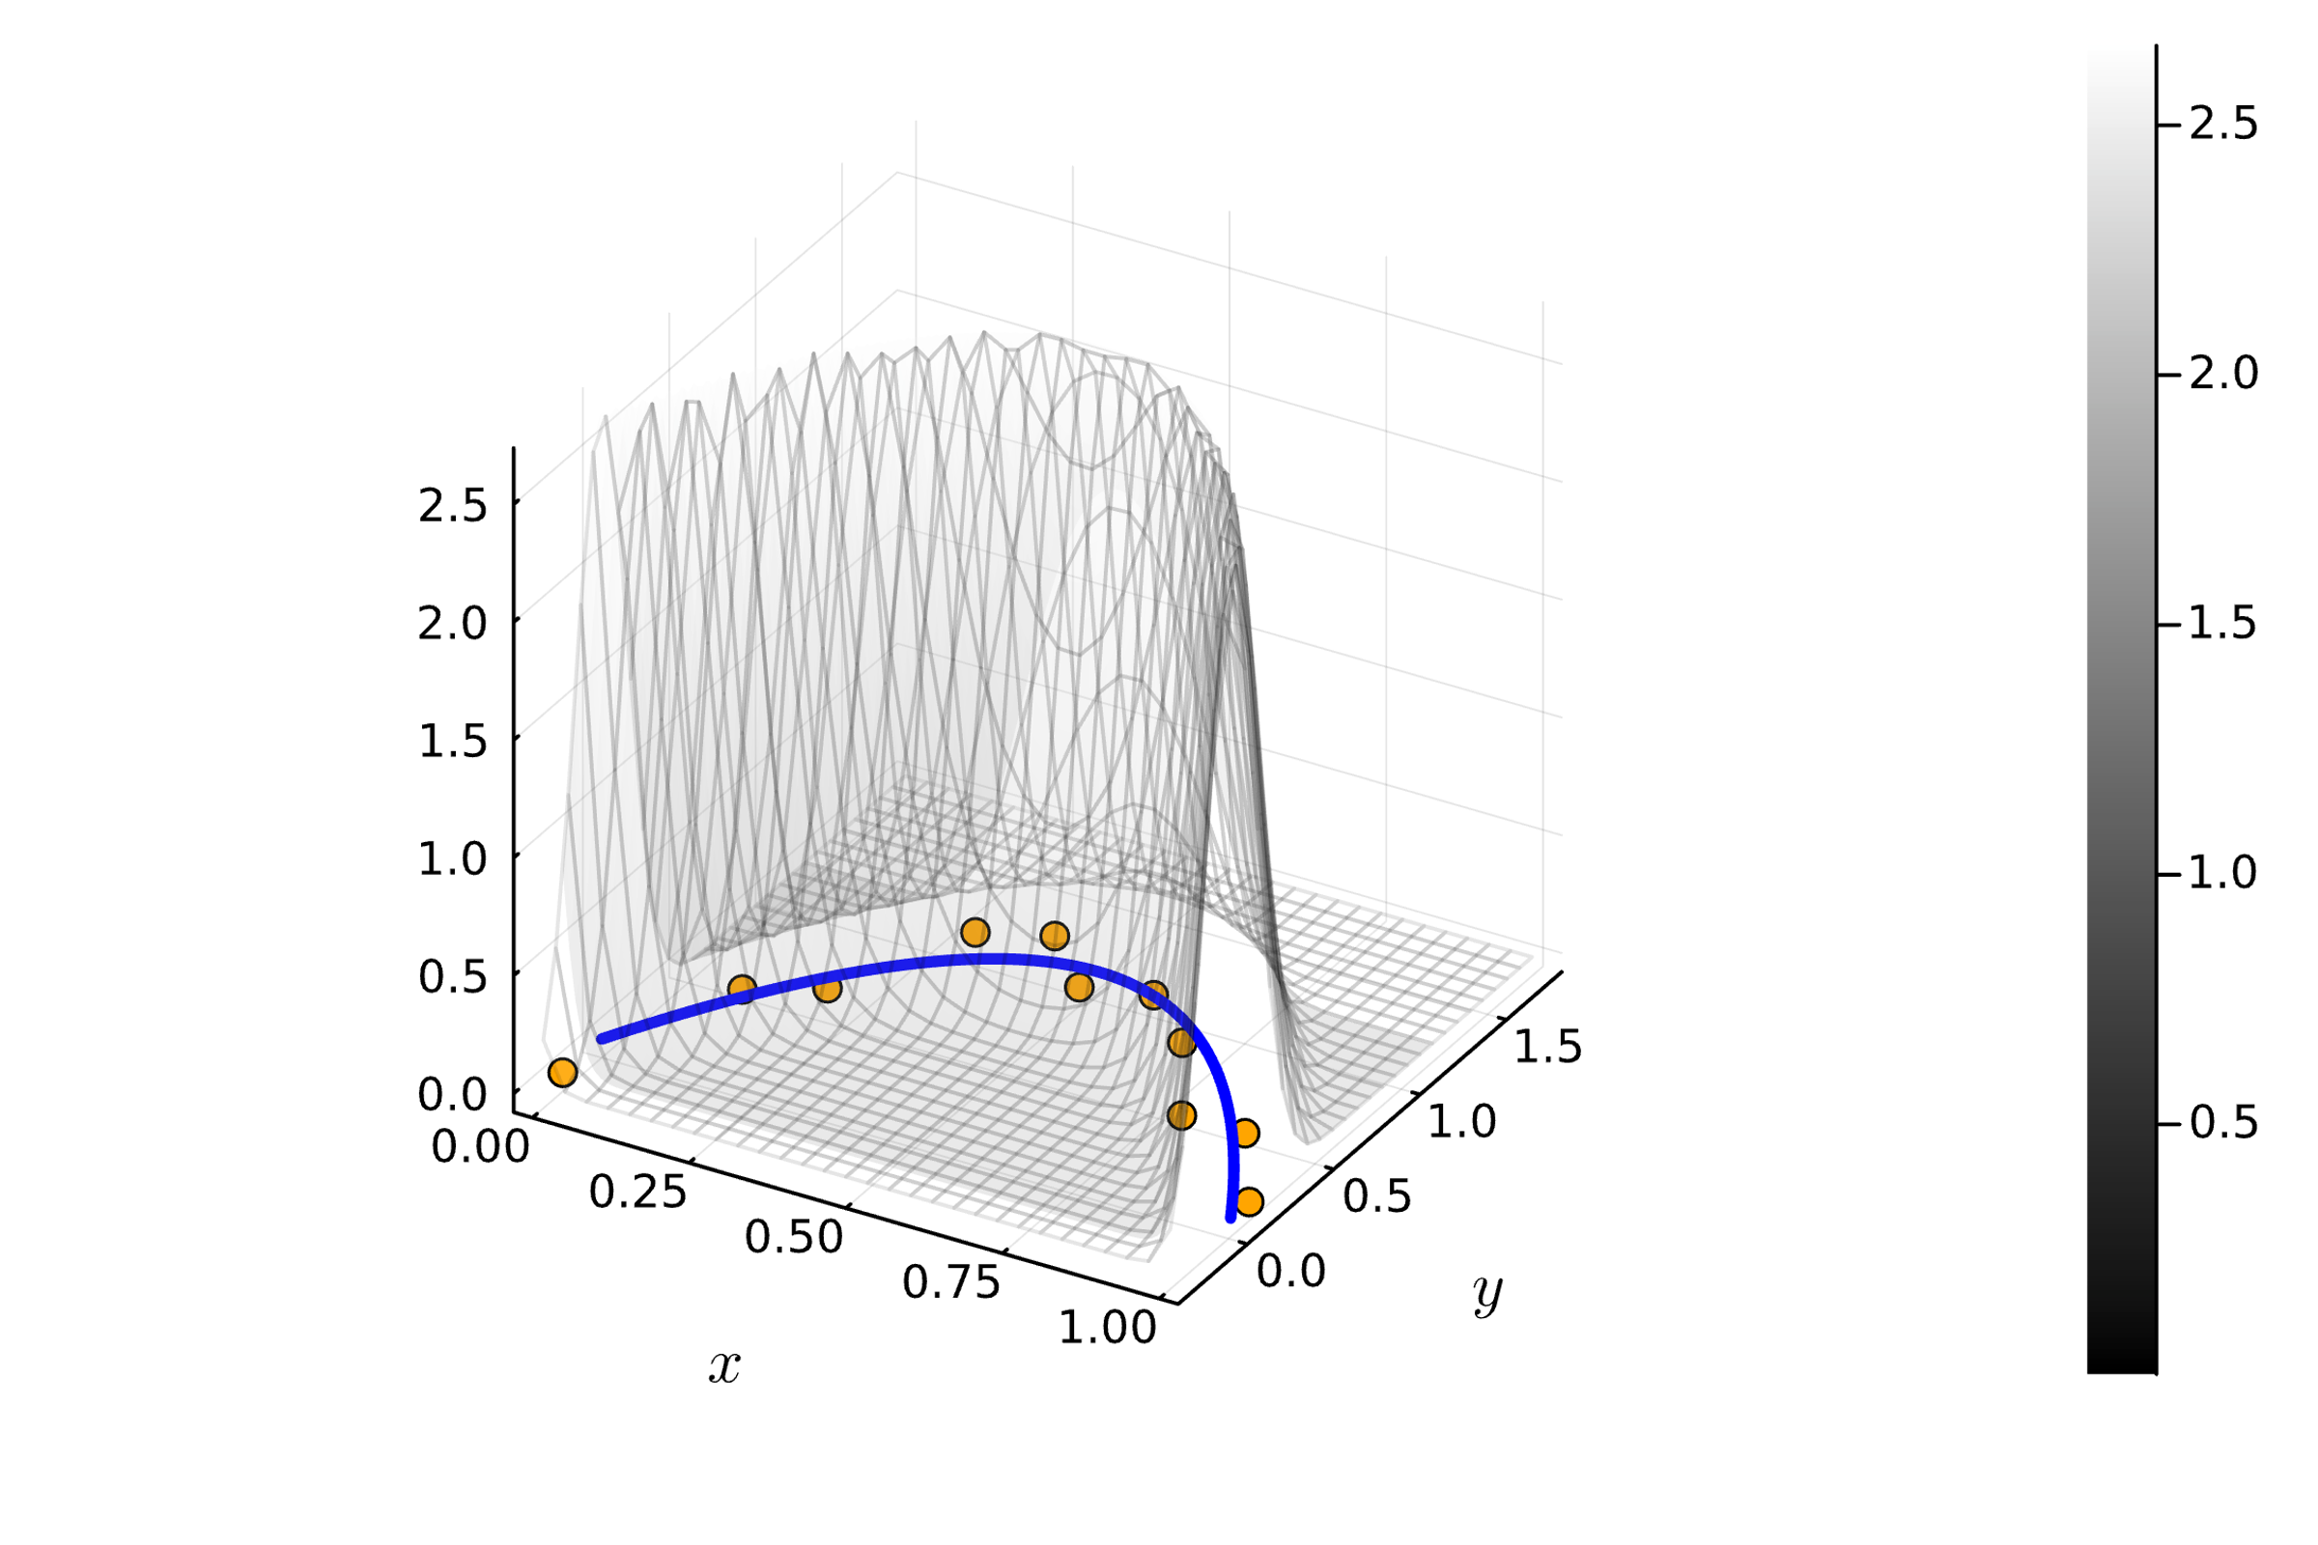
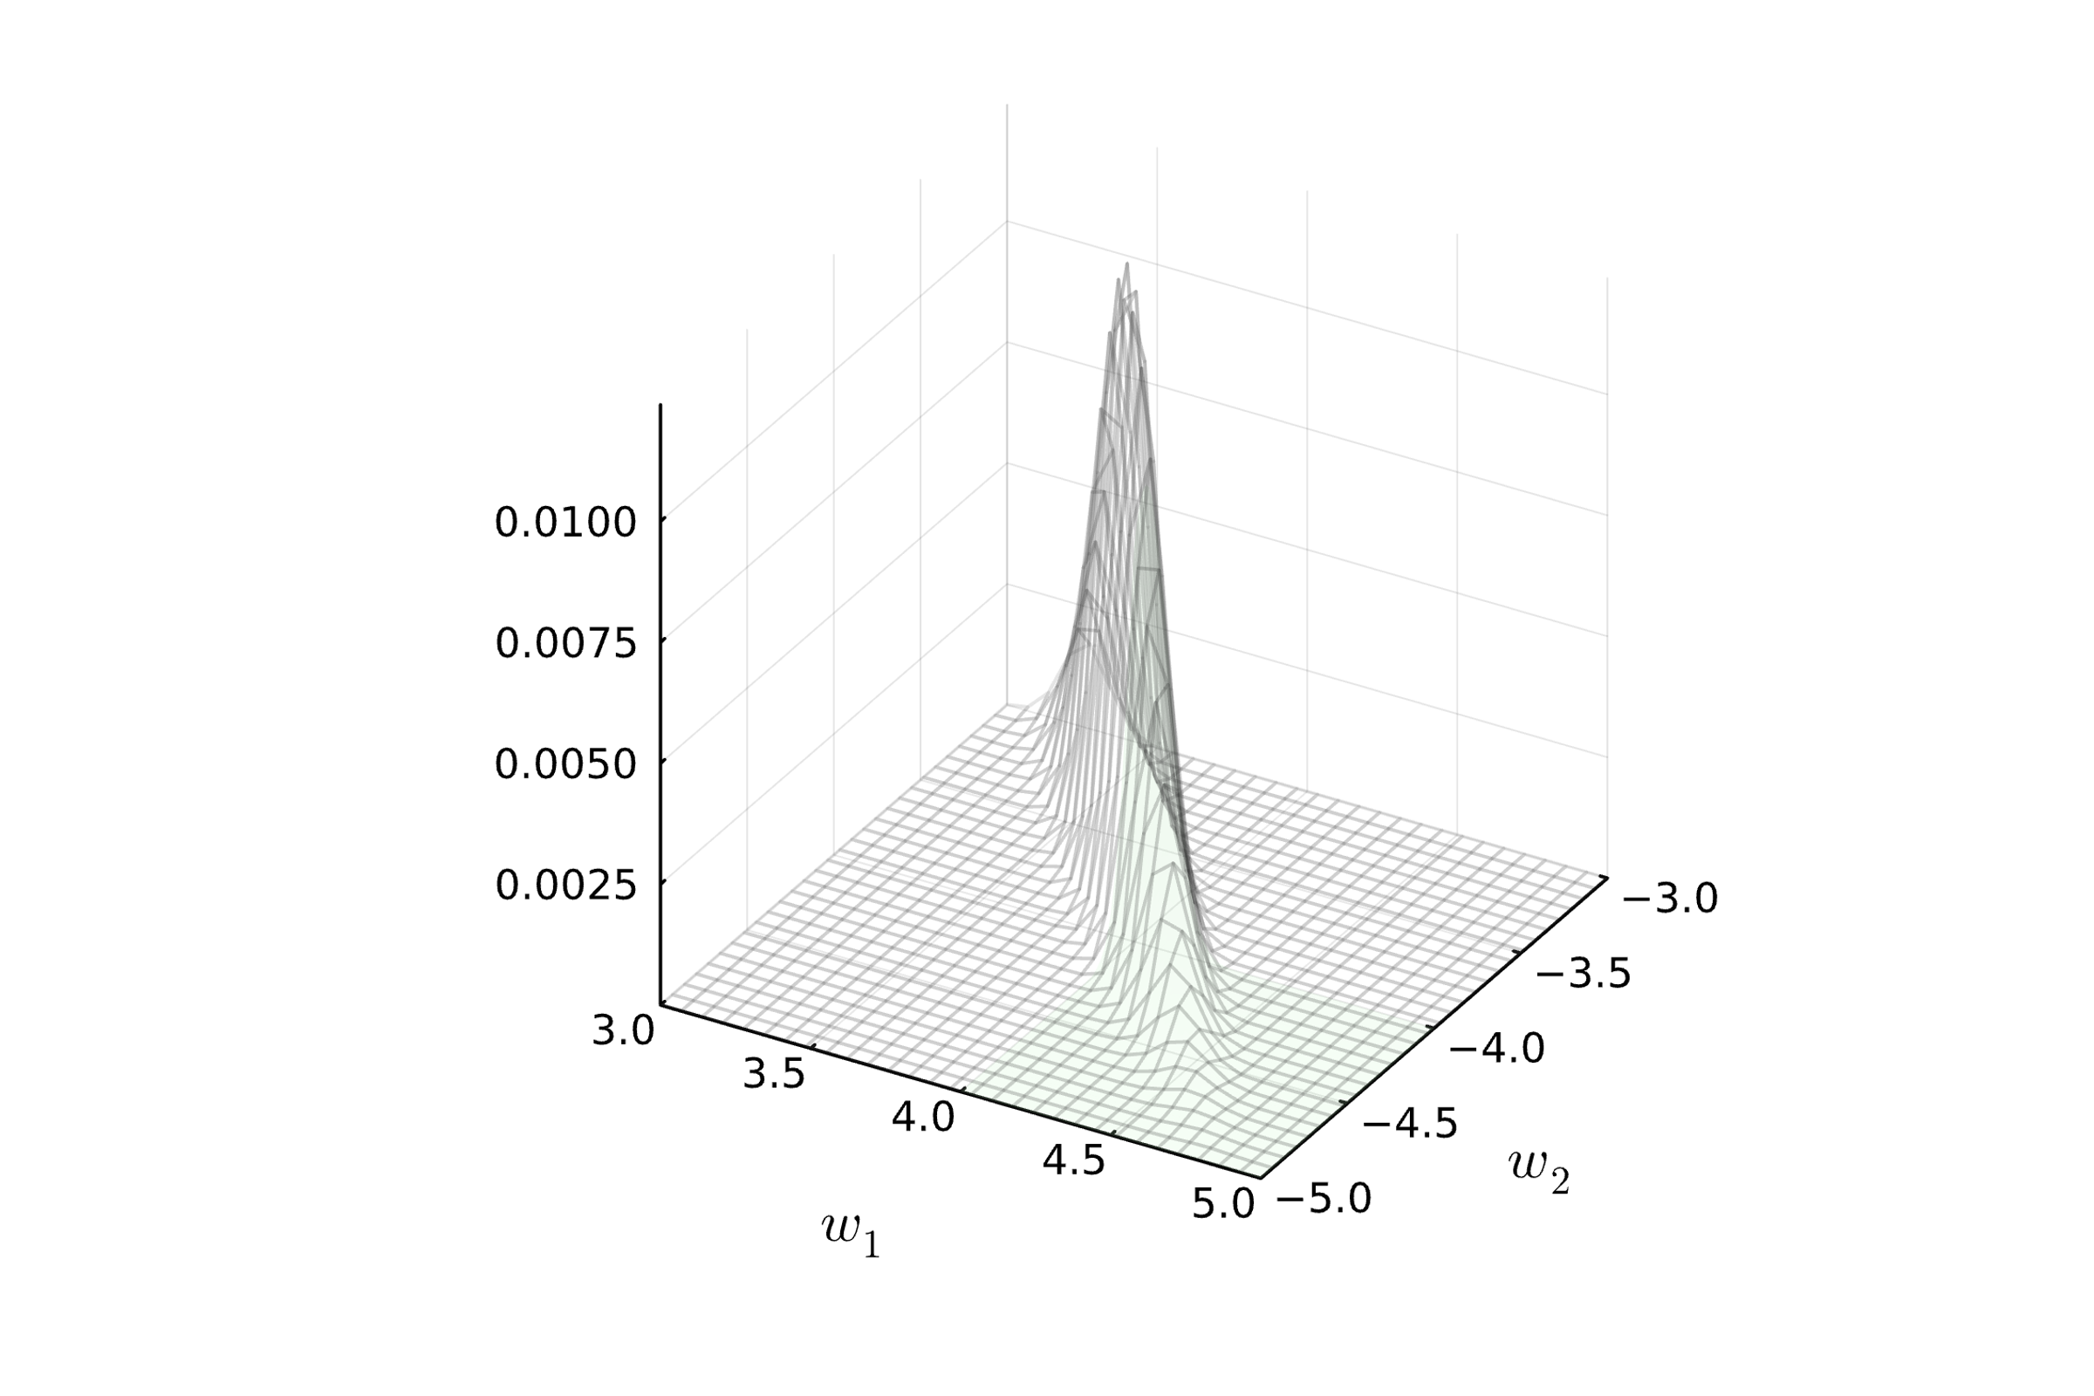

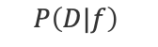
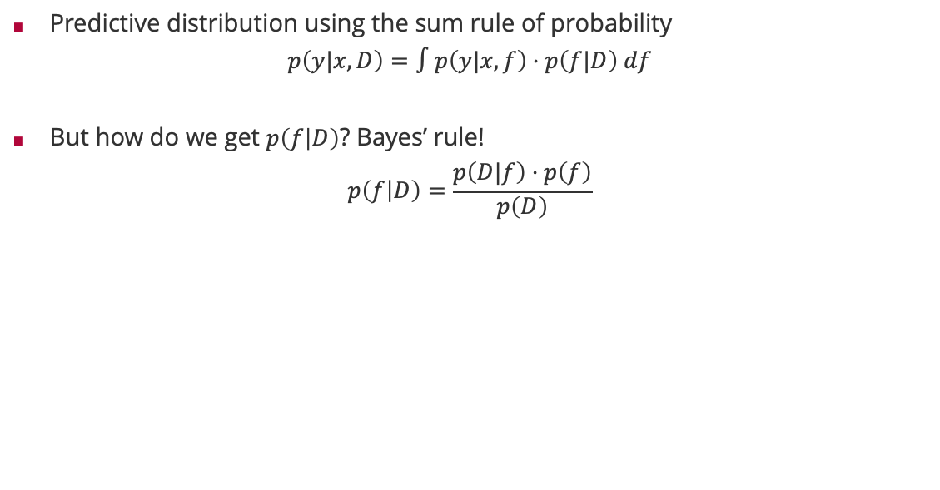
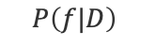
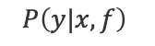
Predictions and Predictive Distributions
$$P\left(y|x,f\right)$$
Predictive distribution using the sum rule of probability
$$p\left(y|x,D\right)=∫p\left(y|x,f\right)⋅p\left(f|D\right) df$$
But how do we get $p\left(f | D\right)$? Bayes’ rule!
$$p\left(f | D\right)=\frac{p\left(D|f\right)⋅p\left(f\right)}{p\left(D\right)}$$
$$P\left(f|D\right)$$
$$P\left(D|f\right)$$
$$P\left(f\right)$$

Slide 7
Overview
Inference Methods
Bayesian Inference
Maximum Likelihood Estimation
Decision Making

Slide 8
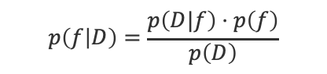
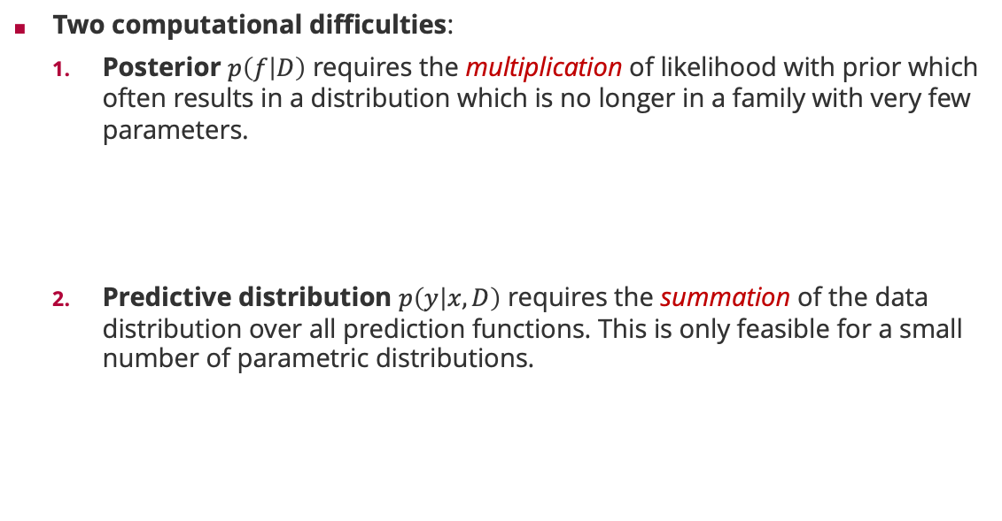
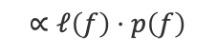
Probabilistic Machine Learning: Bayesian Inference
Two computational difficulties:
Posterior $p\left(f | D\right)$ requires the multiplication of likelihood with prior which often results in a distribution which is no longer in a family with very few parameters.
Predictive distribution $p\left(y | x,D\right)$ requires the summation of the data distribution over all prediction functions. This is only feasible for a small number of parametric distributions.
$$p\left(f | D\right)=\frac{p\left(D|f\right)⋅p\left(f\right)}{p\left(D\right)}$$
$$∝ℓ\left(f\right)⋅p\left(f\right)$$
$$p\left(y|x,D\right)=∫p\left(y|x,f\right)⋅p\left(f|D\right) df$$

Slide 9

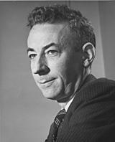
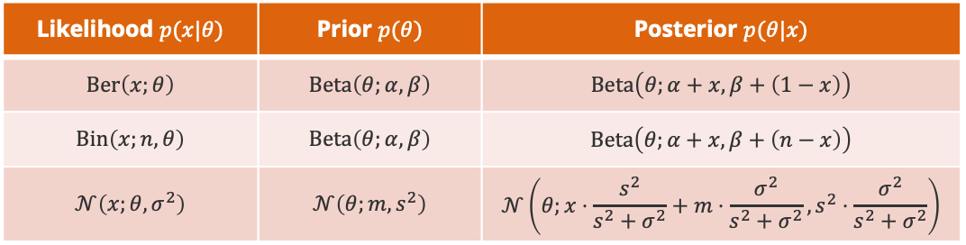
Probability Distributions: Conjugacy
Bayes Rule for Random Variables. For any probability distribution $p$ over two random variables $X$ and $Θ$, it holds
$$p\left(θ|x\right)=\frac{p\left(x|θ\right)⋅p\left(θ\right)}{p\left(x\right)}$$
Conjugacy. A family ${\left\{p\left(x,θ\right)\right\}}_{x,θ}$ is conjugate if the posterior $p\left(θ|x\right)$ is part of the same family as the prior $p\left(θ\right)$ for any value of $x$.
Big Advantage: Computing the exact posterior is computationally efficient!
Likelihood
$$p\left(x,θ\right)$$
Howard Raiffa (1924 – 2016)
Posterior
Prior
Likelihood $p(x|θ)$ | Prior $p(θ)$ | Posterior $p(θ|x)$
$$Ber\left(x;θ\right)$$ | $$Beta\left(θ;α,β\right)$$ | $$Beta\left(θ;α+x,β+\left(1−x\right)\right)$$
$$Bin\left(x;n,θ\right)$$ | $$Beta\left(θ;α,β\right)$$ | $$Beta\left(θ;α+x,β+\left(n−x\right)\right)$$
$$𝒩\left(x;θ,σ^{2}\right)$$ | $$𝒩\left(θ;m,s^{2}\right)$$ | $$𝒩\left(θ;x⋅\frac{s^{2}}{s^{2}+σ^{2}}+m⋅\frac{σ^{2}}{s^{2}+σ^{2}},s^{2}⋅\frac{σ^{2}}{s^{2}+σ^{2}}\right)$$
Robert Osher Schlaifer (1914 – 1994)

Slide 10
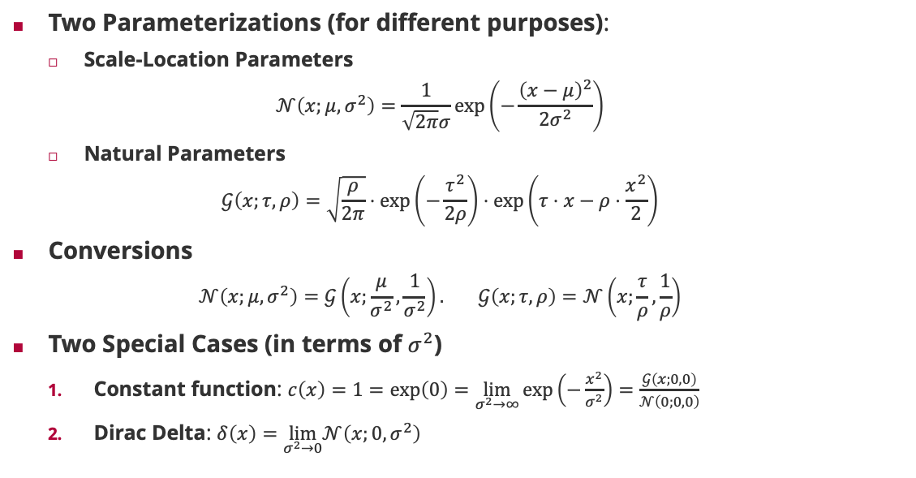
Normal Distribution: Representations
Two Parameterizations (for different purposes):
Scale-Location Parameters
$$𝒩\left(x;μ,σ^{2}\right)=\frac{1}{\sqrt{2π}σ}\exp\left(−\frac{{\left(x−μ\right)}^{2}}{2σ^{2}}\right)$$
Natural Parameters
$$𝒢\left(x;τ,ρ\right)=\sqrt{\frac{ρ}{2π}}⋅\exp\left(−\frac{τ^{2}}{2ρ}\right)⋅\exp\left(τ⋅x−ρ⋅\frac{x^{2}}{2}\right)$$
Conversions
$$𝒩\left(x;μ,σ^{2}\right)=𝒢\left(x;\frac{μ}{σ^{2}},\frac{1}{σ^{2}}\right). 𝒢\left(x;τ,ρ\right)=𝒩\left(x;\frac{τ}{ρ},\frac{1}{ρ}\right)$$
Two Special Cases (in terms of $σ^{2}$)
Constant function: $c\left(x\right)=1=\exp\left(0\right)=\lim_{σ^{2}→∞}{\exp\left(−\frac{x^{2}}{σ^{2}}\right)=\frac{𝒢\left(x;0,0\right)}{𝒩\left(0;0,0\right)}}$
Dirac Delta: $δ\left(x\right)=\lim_{σ^{2}→0}𝒩\left(x;0,σ^{2}\right)$
Two divisions only!

Slide 11
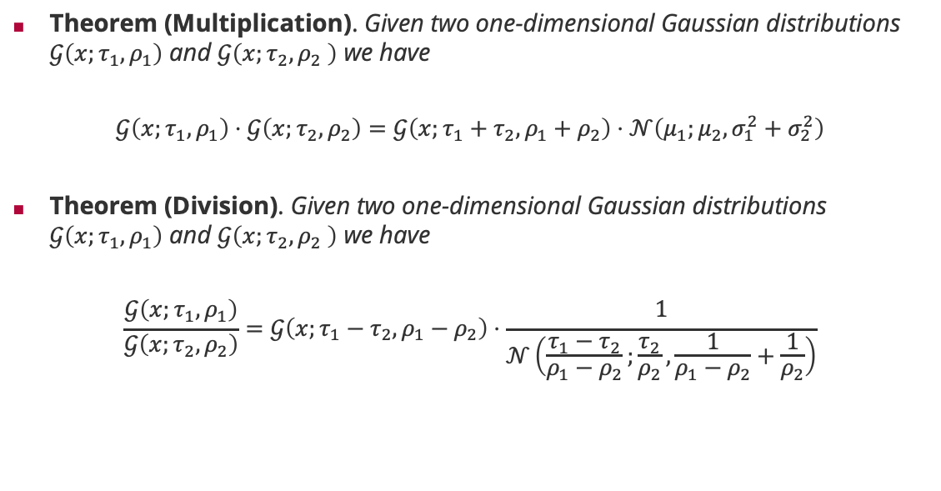
Normal Distributions and the Product Rule
Theorem (Multiplication). Given two one-dimensional Gaussian distributions $𝒢\left(x;τ_{1},ρ_{1}\right)$ and $𝒢\left(x;τ_{2},ρ_{2} \right)$ we have
$$𝒢\left(x;τ_{1},ρ_{1}\right)⋅𝒢\left(x;τ_{2},ρ_{2}\right)=𝒢\left(x;τ_{1}+τ_{2},ρ_{1}+ρ_{2}\right)⋅𝒩\left(μ_{1};μ_{2},σ_{1}^{2}+σ_{2}^{2}\right)$$
Theorem (Division). Given two one-dimensional Gaussian distributions $𝒢\left(x;τ_{1},ρ_{1}\right)$ and $𝒢\left(x;τ_{2},ρ_{2} \right)$ we have
$$\frac{𝒢\left(x;τ_{1},ρ_{1}\right)}{𝒢\left(x;τ_{2},ρ_{2}\right)}=𝒢\left(x;τ_{1}−τ_{2},ρ_{1}−ρ_{2}\right)⋅\frac{1}{𝒩\left(\frac{τ_{1}−τ_{2}}{ρ_{1}−ρ_{2}};\frac{τ_{2}}{ρ_{2}},\frac{1}{ρ_{1}−ρ_{2}}+\frac{1}{ρ_{2}}\right)}$$
Gaussian density
Additive updates!
Gaussian density
Subtractive updates!

Slide 12
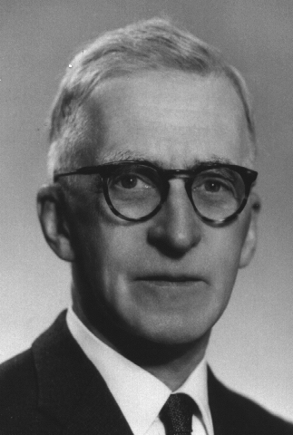
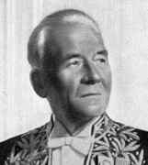
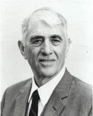
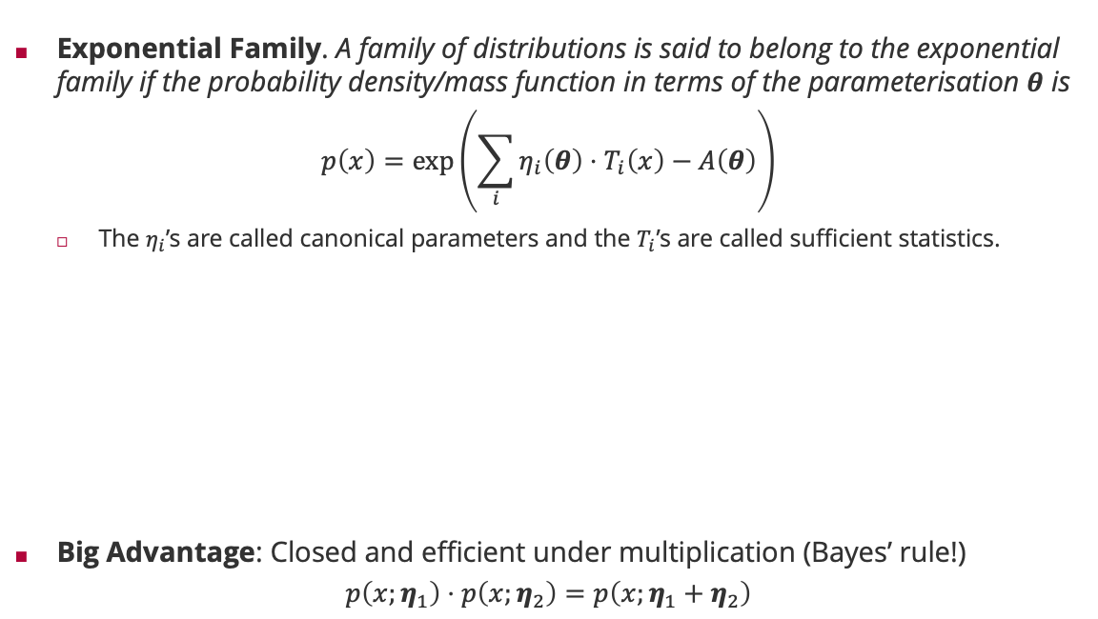
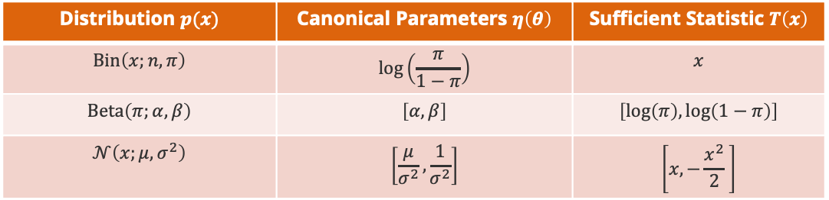
Probability Distributions: Exponential Family
Exponential Family. A family of distributions is said to belong to the exponential family if the probability density/mass function in terms of the parameterisation $θ$ is
$$p\left(x\right)=\exp\left(\sum_{i}{η_{i}\left(θ\right)⋅T_{i}\left(x\right)}−A\left(θ\right)\right)$$
The $η_{i}$’s are called canonical parameters and the $T_{i}$’s are called sufficient statistics.
Big Advantage: Closed and efficient under multiplication (Bayes’ rule!)
$$p\left(x;η_{1}\right)⋅p\left(x;η_{2}\right)=p\left(x;η_{1}+η_{2}\right)$$
Edwin Pitman (1897 - 1993)
Georges Darmois (1888 - 1960)
Distribution $p(x)$ | Canonical Parameters $η\left(θ\right)$ | Sufficient Statistic $T\left(x\right)$
$$Bin\left(x;n,π\right)$$ | $$\log\left(\frac{π}{1−π}\right)$$ | $$x$$
$$Beta\left(π;α,β\right)$$ | $$\left[α,β\right]$$ | $$\left[\log\left(π\right),\log\left(1−π\right)\right]$$
$$𝒩\left(x;μ,σ^{2}\right)$$ | $$\left[\frac{μ}{σ^{2}},\frac{1}{σ^{2}}\right]$$ | $$\left[x,−\frac{x^{2}}{2} \right]$$
Bernhard Koopman (1900 - 1991)

Slide 13
Overview
Inference Methods
Bayesian Inference
Maximum Likelihood Estimation
Decision Making

Slide 14

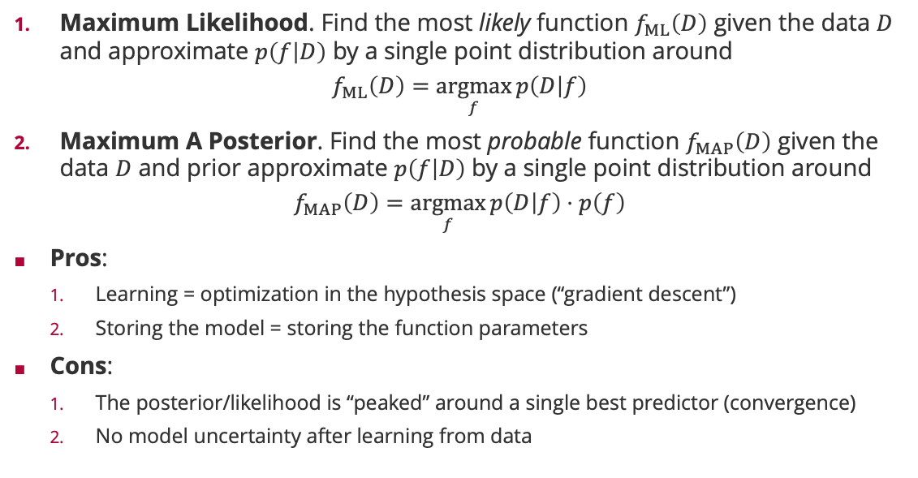
Maximum Likelihood/Maximum A-Posteriori Inference
Maximum Likelihood. Find the most likely function $f_{ML}\left(D\right)$ given the data $D$ and approximate $p\left(f | D\right)$ by a single point distribution around
$$f_{ML}\left(D\right)=\underset{f}{argmax}{p\left(D | f\right)}$$
Maximum A Posterior. Find the most probable function $f_{MAP}\left(D\right)$ given the data $D$ and prior approximate $p\left(f | D\right)$ by a single point distribution around
$$f_{MAP}\left(D\right)=\underset{f}{argmax}{p\left(D | f\right)⋅p\left(f\right)}$$
Pros:
Learning = optimization in the hypothesis space (“gradient descent”)
Storing the model = storing the function parameters
Cons:
The posterior/likelihood is “peaked” around a single best predictor (convergence)
No model uncertainty after learning from data
Sir Ronald Fisher (1890 – 1962)

Slide 15
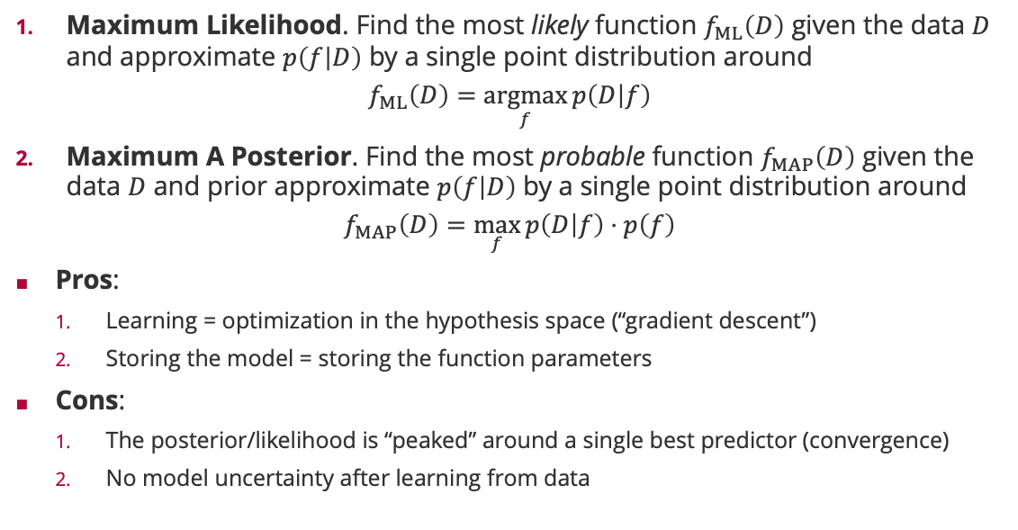
Maximum Likelihood/Maximum A-Posteriori Inference
Maximum Likelihood. Find the most likely function $f_{ML}\left(D\right)$ given the data $D$ and approximate $p\left(f | D\right)$ by a single point distribution around
$$f_{ML}\left(D\right)=\underset{f}{argmax}{p\left(D | f\right)}$$
Maximum A Posterior. Find the most probable function $f_{MAP}\left(D\right)$ given the data $D$ and prior approximate $p\left(f | D\right)$ by a single point distribution around
$$f_{MAP}\left(D\right)=\max_{f}{p\left(D | f\right)⋅p\left(f\right)}$$
Pros:
Learning = optimization in the hypothesis space (“gradient descent”)
Storing the model = storing the function parameters
Cons:
The posterior/likelihood is “peaked” around a single best predictor (convergence)
No model uncertainty after learning from data
Sir Ronald Fisher (1890 – 1962)

Slide 16
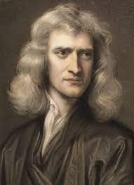
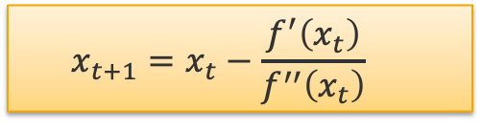
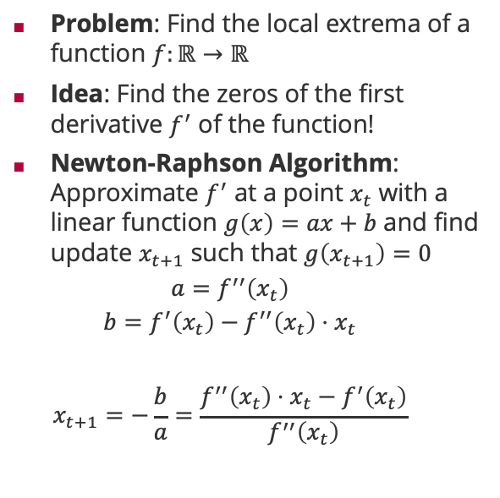
Newton-Raphson Algorithm
Problem: Find the local extrema of a function $f:ℝ→ℝ$
Idea: Find the zeros of the first derivative $f^{′}$ of the function!
Newton-Raphson Algorithm: Approximate $f^{′}$ at a point $x_{t}$ with a linear function $g\left(x\right)=ax+b$ and find update $x_{t+1}$ such that $g\left(x_{t+1}\right)=0$
$$a=f^{′′}\left(x_{t}\right)$$
$$b=f^{′}\left(x_{t}\right)−f^{′′}\left(x_{t}\right)⋅x_{t}$$
$$x_{t+1}=−\frac{b}{a}=\frac{f^{′′}\left(x_{t}\right)⋅x_{t}−f^{′}\left(x_{t}\right)}{f^{′′}\left(x_{t}\right)}$$
Sir Isaac Newton (1643 – 1727)
$$x_{t+1}=x_{t}−\frac{f^{′}\left(x_{t}\right)}{f^{′′}\left(x_{t}\right)}$$

Slide 17
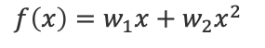
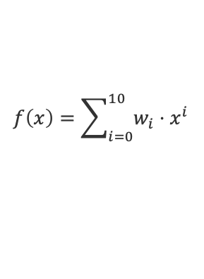
Maximum A-Posteriori Inference: Polynomial Regression
$$f\left(x\right)=w_{1}x+w_{2}x^{2}$$
$f\left(x\right)=w_{0}+w_{1}x+w_{2}x^{2}+w_{3}x^{3}$ $+w_{4}x^{4}+w_{5}x^{5}$ $+w_{6}x^{6}$
$$f\left(x\right)=\sum_{i=0}^{10}{w_{i}⋅x^{i}}$$

Slide 18
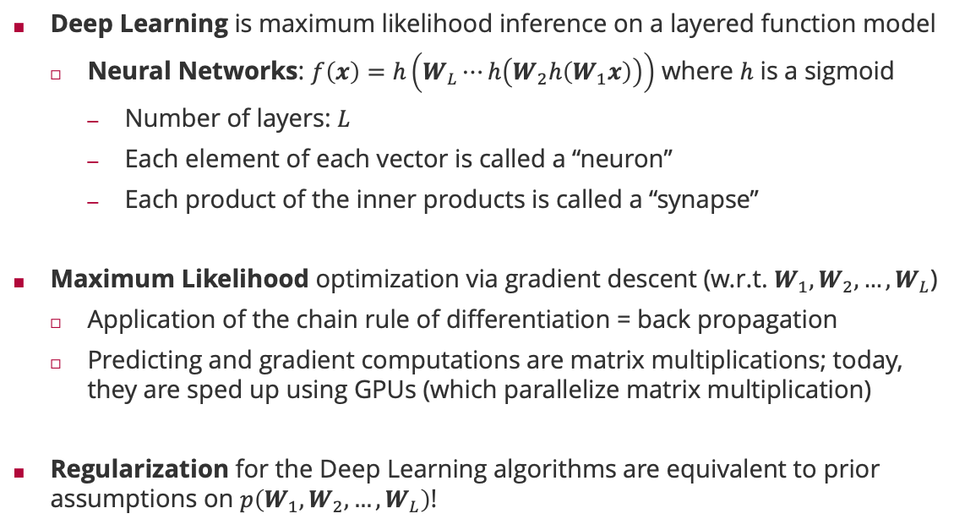
Relation to Deep Learning
Deep Learning is maximum likelihood inference on a layered function model
Neural Networks: $f\left(x\right)=h\left(W_{L}⋯h\left(W_{2}h\left(W_{1}x\right)\right)\right)$ where $h$ is a sigmoid
Number of layers: $L$
Each element of each vector is called a “neuron”
Each product of the inner products is called a “synapse”
Maximum Likelihood optimization via gradient descent (w.r.t. $W_{1},W_{2},…,W_{L}$)
Application of the chain rule of differentiation = back propagation
Predicting and gradient computations are matrix multiplications; today, they are sped up using GPUs (which parallelize matrix multiplication)
Regularization for the Deep Learning algorithms are equivalent to prior assumptions on $p\left(W_{1},W_{2},…,W_{L}\right)$!

Slide 19
Overview
Inference Methods
Bayesian Inference
Maximum Likelihood Estimation
Decision Making

Slide 20
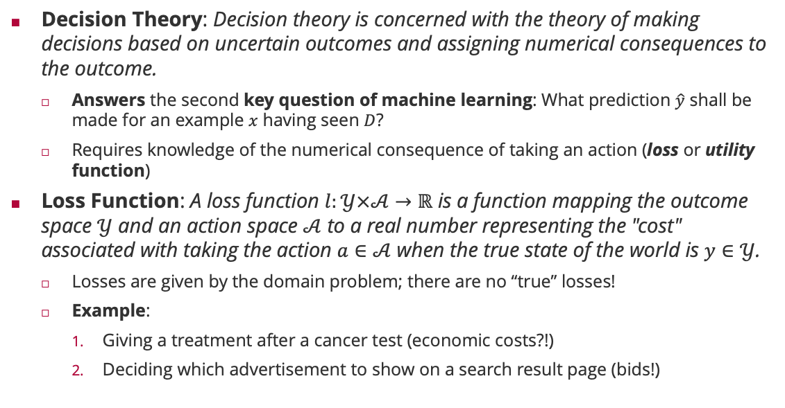
Loss Functions
Decision Theory: Decision theory is concerned with the theory of making decisions based on uncertain outcomes and assigning numerical consequences to the outcome.
Answers the second key question of machine learning: What prediction $\hat{y}$ shall be made for an example $x$ having seen $D$?
Requires knowledge of the numerical consequence of taking an action (loss or utility function)
Loss Function: A loss function $l:𝒴×𝒜→ℝ$ is a function mapping the outcome space $𝒴$ and an action space $𝒜$ to a real number representing the "cost" associated with taking the action $a∈𝒜$ when the true state of the world is $y∈𝒴$.
Losses are given by the domain problem; there are no “true” losses!
Example:
Giving a treatment after a cancer test (economic costs?!)
Deciding which advertisement to show on a search result page (bids!)
 |  | Actions
 |  | treat | nothing
Outcomes | Cancer | 0 | 1000
 | No cancer | 1 | 0

Slide 21
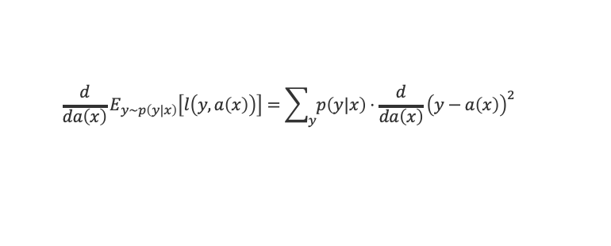
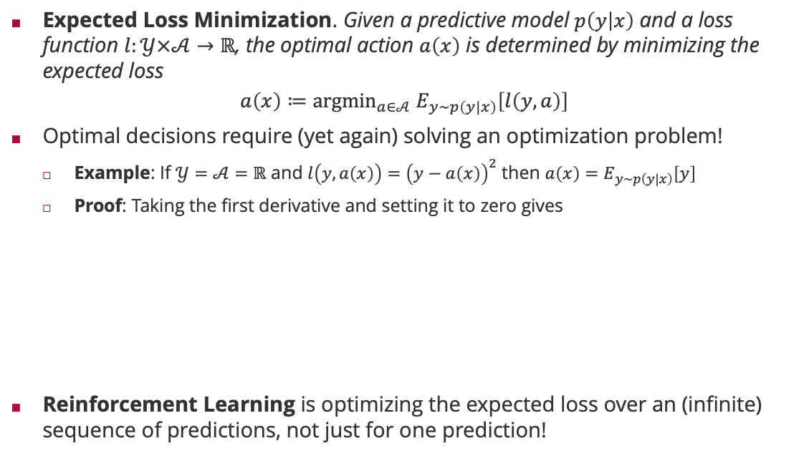
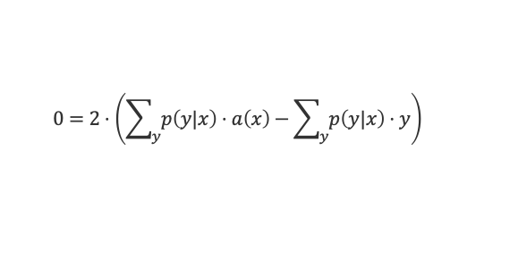

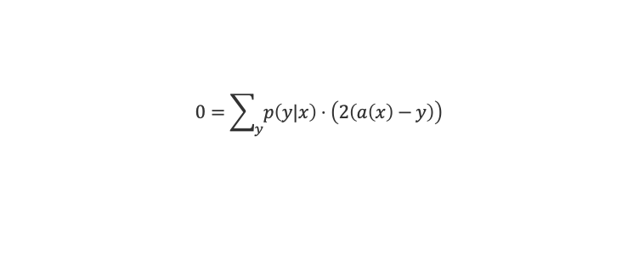
Optimal Decisions
Expected Loss Minimization. Given a predictive model $p\left(y | x\right)$ and a loss function $l:𝒴×𝒜→ℝ$, the optimal action $a\left(x\right)$ is determined by minimizing the expected loss
$$a\left(x\right)≔{argmin}_{a∈𝒜} E_{y∼p\left(y|x\right)}\left[l\left(y,a\right)\right]$$
Optimal decisions require (yet again) solving an optimization problem!
Example: If $𝒴=𝒜=ℝ$ and $l\left(y,a\left(x\right)\right)={\left(y−a\left(x\right)\right)}^{2}$ then $a\left(x\right)=E_{y∼p\left(y|x\right)}\left[y\right]$
Proof: Taking the first derivative and setting it to zero gives
Reinforcement Learning is optimizing the expected loss over an (infinite) sequence of predictions, not just for one prediction!
$$\frac{d}{da\left(x\right)}E_{y∼p\left(y|x\right)}\left[l\left(y,a\left(x\right)\right)\right]=\sum_{y}{p\left(y|x\right)}⋅\frac{d}{da\left(x\right)}{\left(y−a\left(x\right)\right)}^{2}$$
$$0=\sum_{y}{p\left(y|x\right)}⋅\left(2\left(a\left(x\right)−y\right)\right)$$
$$0=2⋅\left(\sum_{y}{p\left(y|x\right)}⋅a\left(x\right)−\sum_{y}{p\left(y|x\right)}⋅y\right)$$
$$0=a\left(x\right)−E_{y∼p\left(y|x\right)}\left[y\right]$$

Slide 22
Example: Binary Classification
Reject at 75% confidence
Decide for 0
Decide for 1

Slide 23
Summary
Inference Methods
Inference is the task of inferring what we know about the plausibility of a prediction function in light of training data
Bayesian Inference is the only consistent inference technique requiring huge summations, but it is (usually) computationally too hard
Maximum Likelihood Estimation is often easier and reduces machine learning to parameter optimization – but we are losing model uncertainty
Decision Making
In order to make automatic decisions, we require domain-specific loss functions
Decision making requires optimization (again!)

Slide 24
See you next week!

